Slide 1
Programming C# 1
16-Apr-18 | Start
17-Apr-18 | 111
Appendix
Online

Slide 2
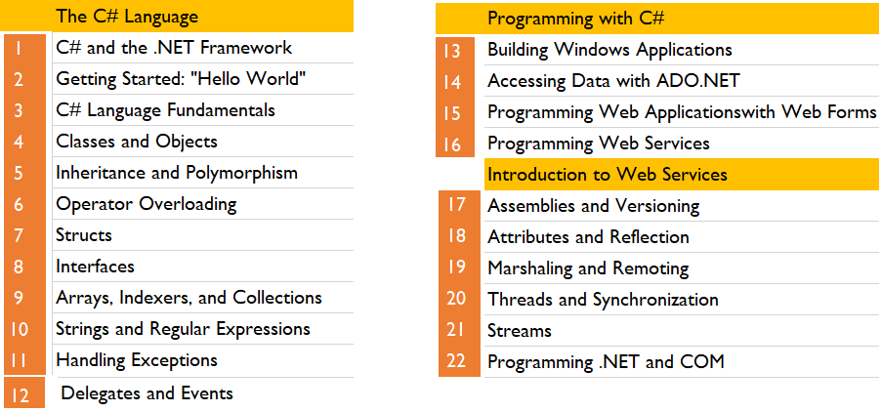
Programming C# 1
Ch | Date
1 | 16 Apr 18
2 | 18 Apr 18
3
4
5
6
7
8
Programming C# 02 2002

Slide 3
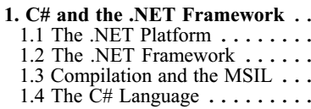
1
C# and the .NET Framework

Slide 4
Intro
The goal of C# is to provide a simple, safe, modern, object-oriented, Internet-centric, high-performance language for .NET development.
C# is a new language, but it draws on the lessons learned over the past three decades.
In much the way that you can see in young children the features and personalities of their parents and grandparents, you can easily see in C# the influence of
Java
C++
Visual Basic (VB)
other languages
The focus of this book is the C# language and its use as a tool for programming on the .NET platform.
In my primers on C++, I advocate learning the language first, without regard to Windows or Unix programming.
With C# that approach would be pointless. You learn C# specifically to create .NET applications; pretending otherwise would miss the point of the language.

Slide 5
Intro |
Thus, this book does not consider C# in a vacuum but places the language firmly in the context of Microsoft's .NET platform and in the development of desktop and Internet applications.
This chapter introduces both the C# language and the .NET platform, including the .NET Framework.

Slide 6
The .NET Platform
When Microsoft announced C# in July 2000, its unveiling was part of a much larger event: the announcement of the .NET platform.
The .NET platform is, in essence, a new development framework that provides a fresh application programming interface (API) to the services and APIs of classic Windows operating systems (especially the Windows 2000 family), while bringing together a number of disparate technologies that emerged from Microsoft during the late 1990s.
Among the latter are
COM+ component services
the ASP web development framework
a commitment to XML and object-oriented design
support for new web services protocols such as SOAP, WSDL, and UDDI
a focus on the Internet
all integrated within the DNA architecture.

Slide 7
Microsoft Commitment
Microsoft says it is devoting 80% of its research and development budget to .NET and its associated technologies.
The results of this commitment to date are impressive. For one thing, the scope of .NET is huge.
The platform consists of four separate product groups:
A set of languages, including C# and Visual Basic .NET
a set of development tools, including Visual Studio .NET;
a comprehensive class library for building web services and web and Windows applications;
as well as the Common Language Runtime (CLR) to execute objects built within this framework.
A set of .NET Enterprise Servers, formerly known as SQL Server 2000, Exchange 2000, BizTalk 2000, and so on, that provide specialized functionality for relational data storage, email, B2B commerce, etc.
An offering of commercial web services, called .NET My Services; for a fee, developers can use these services in building applications that require knowledge of user identity, etc.
New .NET-enabled non-PC devices, from cell phones to game boxes.

Slide 8
The .NET Framework
Microsoft .NET supports not only language independence, but also language integration.
This means that you can inherit from classes, catch exceptions, and take advantage of polymorphism across different languages.
The .NET Framework makes this possible with a specification called the Common Type System (CTS) that all .NET components must obey.
For example, everything in .NET is an object of a specific class that derives from the root class called System.Object.
The CTS supports the general concept of classes, interfaces, delegates (which support callbacks), reference types, and value types.
Additionally, .NET includes a Common Language Specification (CLS), which provides a series of basic rules that are required for language integration.
The CLS determines the minimum requirements for being a .NET language.
Compilers that conform to the CLS create objects that can interoperate with one another.
The entire Framework Class Library (FCL) can be used by any language that conforms to the CLS.

Slide 9
.NET Framework Architecture
The .NET Framework sits on top of the operating system, which can be any flavor of Windows, and consists of a number of components.
Currently, the .NET Framework consists of:
Four official languages: C#, VB.NET, Managed C++, and JScript .NET
The Common Language Runtime (CLR), an object-oriented platform for Windows and web development that all these languages share
A number of related class libraries, collectively known as the Framework Class Library (FCL).
Figure 1-1 breaks down the .NET Framework into its system architectural components.

Slide 10
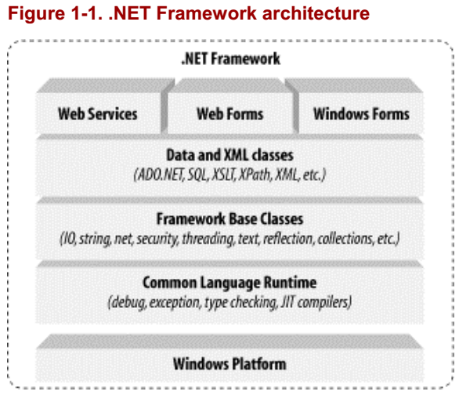
Figure 1-1

Slide 11
CLR
The most important component of the .NET Framework is the CLR, which provides the environment in which programs are executed.
The CLR includes a virtual machine, analogous in many ways to the Java virtual machine.
At a high level,
the CLR activates objects
performs security checks on them
lays them out in memory
executes them
garbage-collects them
The CTS is also part of the CLR.

Slide 12
Framework Class Library
In Figure 1-1, the layer on top of the CLR is
a set of framework base classes,
followed by an additional layer of data and XML classes,
plus another layer of classes intended for web services, Web Forms, and Windows Forms.
Collectively, these classes are known as the Framework Class Library (FCL), one of the largest class libraries in history and one that provides an object-oriented API to all the functionality that the .NET platform encapsulates.
With more than 4,000 classes, the FCL facilitates rapid development of desktop, client/server, and other web services and applications.

Slide 13
Framework Base Classes
The set of framework base classes, the lowest level of the FCL, is similar to the set of classes in Java.
These classes support rudimentary
Input and output
String manipulation
Security management
Network communication
Thread management
Text manipulation
Reflection
Collections functionality, etc.

Slide 14
Data and XML Classes
Above the FCL level is a tier of classes that extend the base classes to support
data management and
XML manipulation
The data classes support persistent management of data that is maintained on backend databases.
These classes include the Structured Query Language (SQL) classes to let you manipulate persistent data stores through a standard SQL interface.
Additionally, a set of classes called ADO.NET allows you to manipulate persistent data.
The .NET Framework also supports a number of classes to let you
manipulate XML data
perform XML searching and translations

Slide 15
Applied Technologies
Extending the framework base classes and the data and XML classes is a tier of classes geared toward building applications using three different technologies:
Web Services
Web Forms
Windows Forms
Web services include a number of classes that support the development of lightweight distributed components, which will work even in the face of firewalls and NAT software.
Because web services employ standard HTTP and SOAP as underlying communications protocols, these components support plug-and-play across cyberspace.
Web Forms and Windows Forms allow you to apply Rapid Application Development techniques to building web and Windows applications.
Simply drag and drop controls onto your form, double-click a control, and write the code to respond to the associated event.
Note: For a more detailed description of the .NET Framework, see .NET Framework Essentials, by Thuan Thai and Hoag Lam (published by O'Reilly & Associates, 2001).

Slide 16
Compilation and the MSIL
In .NET, programs are not compiled into executable files; they are compiled into Microsoft Intermediate Language (MSIL) files, which the CLR then executes.
The MSIL (often shortened to IL) files that C# produces are identical to the IL files that other .NET languages produce; the platform is language-agnostic.
A key fact about the CLR is that it is common; the same runtime supports development in C# as well as in VB.NET. C# code is compiled into IL when you build your project.
The IL is saved in a file on disk. When you run your program, the IL is compiled again, using the Just In Time (JIT) compiler (a process often called JIT'ing). The result is machine code, executed by the machine's processor.
The standard JIT compiler runs on demand. When a method is called, the JIT compiler analyzes the IL and produces highly efficient machine code, which runs very fast.
The JIT compiler is smart enough to recognize when the code has already been compiled, so as the application runs, compilation happens only as needed.
As .NET applications run, they tend to become faster and faster, as the already compiled code is reused.
The CLS means that all .NET languages produce very similar IL code. As a result, objects created in one language can be accessed and derived from another.
Thus it is possible to create a base class in VB.NET and derive from it in C#.

Slide 17
The C# Language
The C# language is disarmingly simple, with only about 80 keywords and a dozen built-in datatypes, but C# is highly expressive when it comes to implementing modern programming concepts.
C# includes all the support for structured, component-based, object-oriented programming that one expects of a modern language built on the shoulders of C++ and Java.
The C# language was developed by a small team led by two distinguished Microsoft engineers, Anders Hejlsberg and Scott Wiltamuth.
Hejlsberg is also known for creating Turbo Pascal, a popular language for PC programming, and for leading the team that designed Borland Delphi, one of the first successful IDE for client/server programming.
At the heart of any object-oriented language is its support for defining and working with classes.
Classes define new types, allowing you to extend the language to better model the problem you are trying to solve.
C# contains keywords for declaring new classes and their methods and properties, and for implementing encapsulation, inheritance, and polymorphism, the three pillars of object-oriented programming.

Slide 18
Classes
In C# everything pertaining to a class declaration is found in the declaration itself.
C# class definitions do not require separate header files or Interface Definition Language (IDL) files.
Moreover, C# supports a new XML style of inline documentation that greatly simplifies the creation of online and print reference documentation for an application.

Slide 19
Interfaces
C# also supports interfaces, a means of making a contract with a class for services that the interface stipulates.
In C#, a class can inherit from only a single parent, but a class can implement multiple interfaces.
When it implements an interface, a C# class in effect promises to provide the functionality the interface specifies.

Slide 20
Structures
C# also provides support for structs, a concept whose meaning has changed significantly from C++.
In C#, a struct is a restricted, lightweight type that, when instantiated, makes fewer demands on the operating system and on memory than a conventional class does.
A struct can't inherit from a class or be inherited from, but a struct can implement an interface.

Slide 21
Component-oriented features
C# provides component-oriented features, such as
Properties
Events
Declarative constructs (called attributes).
Component-oriented programming is supported by the CLR's support for storing metadata with the code for the class.
The metadata describes the class,
including its methods and properties,
as well as its security needs and other attributes, such as whether it can be serialized;
the code contains the logic necessary to carry out its functions.
A compiled class is thus a self-contained unit; therefore, a hosting environment that knows how to read a class' metadata and code needs no other information to make use of it.
Using C# and the CLR, it is possible to add custom metadata to a class by creating custom attributes.
Likewise, it is possible to read class metadata using CLR types that support reflection.

Slide 22
Assembly
An assembly is a collection of files that appear to the programmer to be a single dynamic link library (DLL) or executable (EXE).
In .NET, an assembly is the basic unit of
Reuse
Versioning
Security
Deployment
The CLR provides a number of classes for manipulating assemblies.
A final note about C# is that it also provides support for directly accessing memory using C++ style pointers and keywords for bracketing such operations as unsafe, and for warning the CLR garbage collector not to collect objects referenced by pointers until they are released.

Slide 23
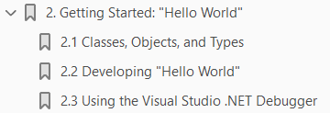
2
Getting Started: “Hello World”

Slide 24
Intro
It is a time-honored tradition to start a programming book with a "Hello World" program.
In this chapter, we create, compile, and run a simple "Hello World" program written in C#.
The analysis of this brief program will introduce key features of the C# language.
Example 2-1 illustrates the fundamental elements of a very elementary C# program.
Compiling and running HelloWorld displays the words "Hello World" at the console.
Let's take a closer look at this simple program.

Slide 25
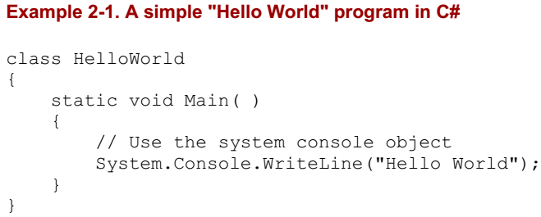
Example 2-1

Slide 26
Classes, Objects, and Types
The essence of object-oriented programming is the creation of new types.
A type represents a thing. Sometimes the thing is abstract, such as a data table or a thread; sometimes it is more tangible, such as a button in a window.
A type defines the thing's general properties and behaviors.
If your program uses three instances of a button type in a window -- say, an OK, a Cancel, and a Help button -- each instance will share certain properties and behaviors.
Each, for example, will have a size (though it might differ from that of its companions), a position (though again, it will almost certainly differ in its position from the others), and a text label (e.g., "OK", "Cancel," and "Help").
Likewise, all three buttons will have common behaviors, such as the ability to be drawn, activated, pressed, and so forth.
Thus, the details might differ among the individual buttons, but they are all of the same type.
As in many object-oriented programming languages, in C# a type is defined by a class, while the individual instances of that class are known as objects.
Later chapters explain that there are other types in C# besides classes, including enums, structs, and delegates, but for now the focus is on classes.

Slide 27
Classes, Objects, and Types |
The "Hello World" program declares a single type: the HelloWorld class.
To define a C# type, you declare it as a class using the class keyword, give it a name -- in this case, HelloWorld -- and then define its properties and behaviors.
The property and behavior definitions of a C# class must be enclosed by open and closed braces ({ } ).

Slide 28
Methods
A class has both properties and behaviors. Behaviors are defined with member methods; properties are discussed in Chapter 3.
A method is a function owned by your class. In fact, member methods are sometimes called member functions.
The member methods define what your class can do or how it behaves.
Typically, methods are given action names, such as WriteLine( ) or AddNumbers( ).
In the case shown here, however, the class method has a special name, Main( ), which doesn't describe an action but does designate to the Common Language Runtime (CLR) that this is the main, or first method, for your class.
Unlike C++, Main is capitalized in C# and can return int or void. The CLR calls Main( ) when your program starts.
Main( )is the entry point for your program, and every C# program must have a Main( ) method.
Method declarations are a contract between the creator of the method and the consumer (user) of the method.
It is likely that the creator and consumer of the method will be the same programmer, but this does not have to be so; it is possible that one member of a development team will create the method and another programmer will use it.

Slide 29

Methods |
To declare a method, you specify a return value type followed by a name.
Method declarations also require parentheses, whether the method accepts parameters or not.
For example:
declares a method named myMethod that takes one parameter: an integer which will be referred to within the method as size.
My method returns an integer value. The return value type tells the consumer of the method what kind of data the method will return when it finishes running.
Some methods do not return a value at all; these are said to return void, which is specified by the void keyword.
For example:
declares a method that returns void and takes no parameters.
In C# you must always declare a return type or void.

Slide 30
Comments
A C# program can also contain comments. Take a look at the first line after the opening brace:
The text begins with two forward slash marks (//). These designate a comment.
A comment is a note to the programmer and does not affect how the program runs.
C# supports three types of comments.
The first type, just shown, indicates that all text to the right of the comment mark is to be considered a comment, until the end of that line.
This is known as a C++ style comment.
The second type of comment, known as a C-Style comment , begins with an open comment mark (/*) and ends with a closed comment mark (*/).
This allows comments to span more than one line without having to have // characters at the beginning of each comment line, as shown in Example 2-2.
It is possible to nest C++ style comments within C-style comments.

Slide 31
Comments
For this reason, it is common to use C++ style comments whenever possible, and to reserve the C-style comments for "commenting-out" blocks of code.
The third and final type of comment that C# supports is used to associate external XML-based documentation with your code, and is illustrated in Chapter 13.

Slide 32
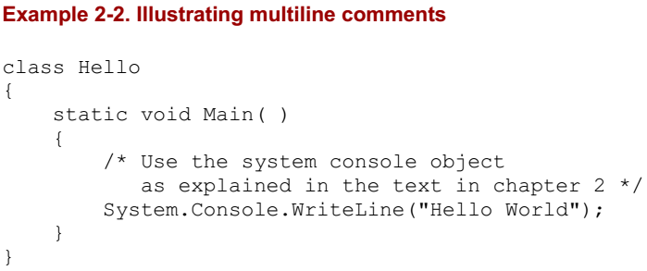
Example 2-2

Slide 33
Console Applications
"Hello World" is an example of a console program.
A console application has no user interface (UI); there are no list boxes, buttons, windows, and so forth.
Text input and output is handled through the standard console (typically a command or DOS window on your PC).
Sticking to console applications for now helps simplify the early examples in this book, and keeps the focus on the language itself.
In later chapters, we'll turn our attention to Windows and web applications, and at that time we'll focus on the Visual Studio .NET UI design tools.
All that the Main( ) method does in this simple example is write the text "Hello World" to the monitor.
The monitor is managed by an object named Console. This Console object has a method WriteLine( ) that takes a string (a set of characters) and writes it to the standard output.
When you run this program, a command or DOS screen will pop up on your computer monitor and display the words "Hello World.“
You invoke a method with the dot operator (. ).
Thus, to call the Console object's WriteLine( )method, you write Console.WriteLine(...), filling in the string to be printed.

Slide 34
Namespaces
Console is only one of a tremendous number of useful types that are part of the .NET FCL.
Each class has a name, and thus the FCL contains thousands of names, such as ArrayList, Hashtable, FileDialog, DataException, EventArgs, and so on.
There are hundreds, thousands, even tens of thousands of names. This presents a problem. No developer can possibly memorize all the names that the .NET Framework uses, and sooner or later you are likely to create an object and give it a name that has already been used.
What will happen if you develop your own Hashtable class, only to discover that it conflicts with the Hashtable class that .NET provides?
Remember, each class in C# must have a unique name. You certainly could rename your Hashtable class mySpecialHashtable, for example, but that is a losing battle.
New Hashtable types are likely to be developed, and distinguishing between their type names and yours would be a nightmare.
The solution to this problem is to create a namespace. A namespace restricts a name's scope, making it meaningful only within the defined namespace.
Assume that I tell you that Jim is an engineer. The word "engineer" is used for many things in English, and can cause confusion. Does he design buildings? Write software? Run a train?

Slide 35
Namespaces |
In English I might clarify by saying "he's a scientist," or "he's a train engineer.“
A C# programmer could tell you that Jim is a science.engineer rather than a train.engineer.
The namespace (in this case, science or train) restricts the scope of the word that follows. It creates a "space" in which that name is meaningful.
Further, it might happen that Jim is not just any kind of science.engineer.
Perhaps Jim graduated from MIT with a degree in software engineering, not civil engineering (are civil engineers especially polite?).
Thus, the object that is Jim might be defined more specifically as a science.software.engineer.
This classification implies that the namespace software is meaningful within the namespace science, and that engineer in this context is meaningful within the namespace software.
If later you learn that Charlotte is a transportation.train.engineer, you will not be confused as to what kind of engineer she is.
The two uses of engineer can coexist, each within its own namespace.
Similarly, if it turns out that .NET has a Hashtable class within its System.Collections namespace, and that I have also created a Hashtable class within a ProgCSharp.DataStructures namespace, there is no conflict because each exists in its own namespace.

Slide 36

Namespaces ||
In Example 2-1, the Console object's name is restricted to the System namespace by using the code:

Slide 37
The Dot Operator (.)
In Example 2-1, the dot operator (.) is used both to access a method (and data) in a class (in this case, the method WriteLine( )), and to restrict the class name to a specific namespace (in this case, to locate Console within the System namespace).
This works well because in both cases we are "drilling down" to find the exact thing we want.
The top level is the System namespace (which contains all the System objects that the Framework provides); the Console type exists within that namespace, and the WriteLine( ) method is a member function of the Console type.
In many cases, namespaces are divided into subspaces.
For example, the System namespace contains a number of subnamespaces such as Configuration , Collections, Data, and so forth, while the Collections namespace itself is divided into multiple subnamespaces.
Namespaces can help you organize and compartmentalize your types.
When you write a complex C# program, you might want to create your own namespace hierarchy, and there is no limit to how deep this hierarchy can be.
The goal of namespaces is to help you divide and conquer the complexity of your object hierarchy.

Slide 38
The using Keyword
Rather than writing the word System before Console, you could specify that you will be using types from the System namespace by writing the statement:
at the top of the listing, as shown in Example 2-3.
Notice the using System statement is placed before the HelloWorld class definition.
Although you can designate that you are using the System namespace, unlike with some languages you cannot designate that you are using the System.Console object.
Example 2-4 will not compile.
This generates the compile error: Listing 2-0.
The using keyword can save a great deal of typing, but it can undermine the advantages of namespaces by polluting the namespace with many undifferentiated names.
A common solution is to use the using keyword with the built-in namespaces and with your own corporate namespaces, but perhaps not with third-party components.

Slide 39
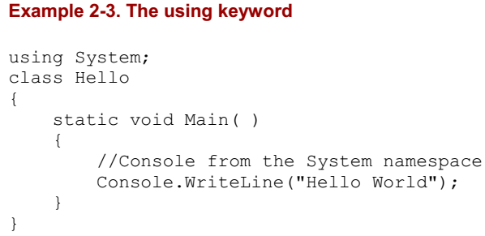
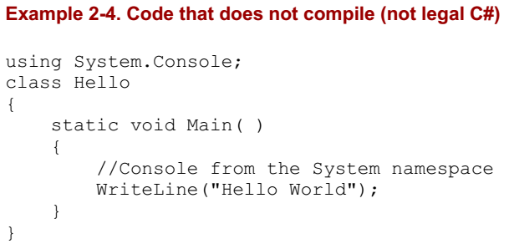
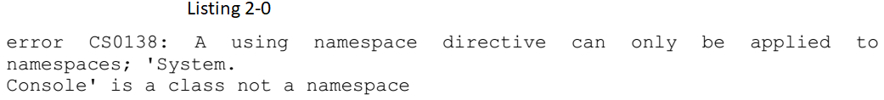
Example 2-3 || 2-4 || Listing 2-0

Slide 40
Case Sensitivity
C# is case-sensitive, which means that writeLine is not the same as WriteLine, which in turn is not the same as WRITELINE.
Unfortunately, unlike in Visual Basic (VB), the C# development environment will not fix your case mistakes; if you write the same word twice with different cases, you might introduce a tricky-to-find bug into your program.
To prevent such a time-wasting and energy-depleting mistake, you should develop conventions for naming your variables, functions, constants, and so forth.
The convention in this book is to name variables with camel notation (e.g., someVariableName), and to name functions, constants, and properties with Pascal notation (e.g., SomeFunction).

Slide 41

The static Keyword
The Main( ) method shown in Example 2-1 has one more designation.
Just before the return type declaration void (which, you will remember, indicates that the method does not return a value) you'll find the keyword static:
The static keyword indicates that you can invoke Main( ) without first creating an object of type Hello.
This somewhat complex issue will be considered in much greater detail in subsequent chapters.
One of the problems with learning a new computer language is you must use some of the advanced features before you fully understand them.
For now, you can treat the declaration of the Main( ) method as tantamount to magic.

Slide 42
Developing "Hello World"
There are at least two ways to enter, compile, and run the programs in this book: use the Visual Studio .NET Integrated Development Environment (IDE), or use a text editor and a command-line compiler (along with some additional command-line tools to be introduced later).
Although you can develop software outside Visual Studio .NET, the IDE provides enormous advantages.
These include indentation support, Intellisense word completion, color coding, and integration with the help files.
Most important, the IDE includes a powerful debugger and a wealth of other tools.
Although this book tacitly assumes that you'll be using Visual Studio .NET, the tutorials focus more on the language and the platform than on the tools.
You can copy all the examples into a text editor such as Windows Notepad or Emacs, save them as text files, and compile them with the C# command-line compiler that is distributed with the .NET Framework SDK.
Note that some examples in later chapters use Visual Studio .NET tools for creating Windows Forms and Web Forms, but even these you can write by hand in Notepad if you are determined to do things the hard way.

Slide 43
Editing "Hello World"
To create the "Hello World" program in the IDE, select Visual Studio .NET from your Start menu or a desktop icon, and then choose File New Project from the menu toolbar.
This will invoke the New Project window (if you are using Visual Studio for the first time, the New Project window might appear without further prompting).
To open your application, select Visual C# Projects in the Project Type window and select Console Application in the Templates window.
You can now enter a name for the project and select a directory in which to store your files.
Click OK, and a new window will appear in which you can enter the code.
Notice that Visual Studio .NET creates a namespace based on the project name you've provided (HelloWorld), and adds a using System statement because nearly every program you write will need types from the System namespace.
Visual Studio .NET creates a class named Class1, which you are free to rename. When you rename the class, be sure to rename the file as well (Class1.cs).
To reproduce Example 2-1, for instance, change the name of Class1 to HelloWorld, and rename the Class1.cs file (listed in the Solution Explorer window) to HelloWorld.cs.

Slide 44
Editing "Hello World“ |
Finally, Visual Studio .NET creates a program skeleton, complete with a TODO comment to get you started.
To reproduce Example 2-1, remove the arguments (string[ ] args) and comments from the Main( ) method.
Then copy the following two lines into the body of Main( ).
If you are not using Visual Studio .NET, open Notepad, type in the code from Example 2-1, and save the file as a text file named Hello.cs.

Slide 45
Compiling and Running "Hello World"
There are many ways to compile and run the "Hello World" program from within Visual Studio .NET.
Typically you can accomplish every task by choosing commands from the Visual Studio .NET menu toolbar, by using buttons, and, in many cases, by using key-combination shortcuts.
For example, to compile the "Hello World" program, press Ctrl-Shift-B or choose Build -> Build Solution.
As an alternative, you can click the Build button on the Build button bar (you may need to right-click on the toolbar to add the Build button bar).
To run the "Hello World" program without the debugger, you can press Ctrl-F5 on your keyboard, choose Debug Start Without Debugging from the IDE menu toolbar, or press the Start Without Debugging button on the IDE Build toolbar.
You can run the program without first explicitly building it; depending on how your options are set (Tools Options) the IDE will save the file, build it, and run it, possibly asking you for permission at each step.

Slide 46
Command-line Compiler
Use the following steps to compile and run the "Hello World" program using the C# command-line compiler:
Save Example 2-1 as the filehello.cs.
Open a command window (Start Run and type in cmd).
From the command line, enter:
This step will build the executable (EXE) file. If the program contains errors, the compiler will report them in the command window.
The /debug command-line switch inserts symbols in the code so you can run the EXE under a debugger or see line numbers in stack traces. (You'll get a stack trace if your program generates an error that you do not handle.)
To run the program, enter:
You should see the venerable words "Hello World" appear in your command window.

Slide 47
Just In Time Compilation
Compiling Hello.cs using csc creates an executable (EXE) file.
Keep in mind, however, that the .exe file contains op-codes written in Microsoft Intermediate Language (MSIL), which is introduced in Chapter 1.
Interestingly, if you had written this application in VB.NET or any other language compliant with the .NET Common Language Specification, you would have compiled it into the same MSIL.
By design, Intermediate Language (IL) code created from different languages is virtually indistinguishable; this is the point of having a common language specification in the first place.
In addition to producing the IL code (which is similar in spirit to Java's byte-code), the compiler creates a read-only segment of the .exe file in which it inserts a standard Win32 executable header.
The compiler designates an entry point within the read-only segment; the operating system loader jumps to that entry point when you run the program, just as it would for any Windows program.
The operating system cannot execute the IL code, however, and that entry point does nothing but jump to the .NET Just In Time (JIT) compiler (also introduced in Chapter 1).
The JIT produces native CPU instructions, as you might find in a normal .exe.
The key feature of a JIT compiler, however, is that functions are compiled only as they are used, Just In Time for execution.

Slide 48
Using the Visual Studio .NET Debugger
Arguably, the single most important tool in any development environment is the debugger.
The Visual Studio debugger is very powerful, and it will be well worth whatever time you put into learning how to use it well.
That said, the fundamentals of debugging are very simple.
The three key skills are:
How to set a breakpoint and how to run to that breakpoint
How to step into and over method calls
How to examine and modify the value of variables, member data, and so forth
This chapter does not reiterate the entire debugger documentation, but these skills are so fundamental that it does provide a crash (pardon the expression) course.
The debugger can accomplish the same thing in many ways -- typically via menu choices, buttons, and so forth.

Slide 49
Breakpoints
The simplest way to set a breakpoint is to click in the lefthand margin.
The IDE will mark your breakpoint with a red dot.
To run the debugger you can choose Debug->Start or just press F5.
The program will compile and run to the breakpoint, at which time it will stop and a yellow arrow will indicate the next statement for execution.
After you've hit your breakpoint it is easy to examine the values of various objects.
For example, you can find the value of the variable i just by putting the cursor over it and waiting a moment.
The debugger IDE also provides a number of very useful windows, such as a Locals window that displays the values of all the local variables.
Intrinsic types such as integers simply show their value (see i earlier), but objects show their type and have a plus (+) sign.
You can expand these objects to see their internal data, as shown in Figure 2-9.
You'll learn more about objects and their internal data in upcoming chapters.
You can step into the next method by pressing F11.

Slide 50
Breakpoints |
Intrinsic types such as integers simply show their value (see i earlier), but objects show their type and have a plus (+) sign.
You can expand these objects to see their internal data, as shown in Figure 2-9.
You'll learn more about objects and their internal data in upcoming chapters.
You can step into the next method by pressing F11. Doing so steps into the DrawWindow( ) method of the WindowClass, as shown in Figure 2-10.
You can see that the next execution statement is now WriteLine in DrawWindow( ).
The autos window has updated to show the current state of the objects.
There is much more to learn about the debugger, but this brief introduction should get you started.
You can answer many programming questions by writing short demonstration programs and examining them in the debugger.
A good debugger is, in some ways, the single most powerful teaching tool for a programming language.

Slide 51
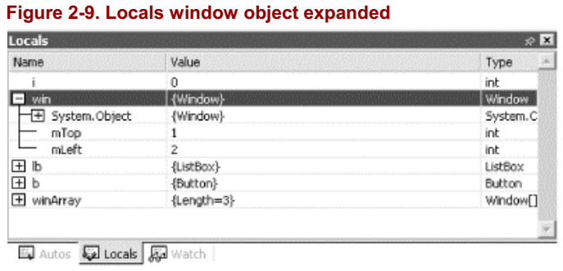
Figure 2-9

Slide 52
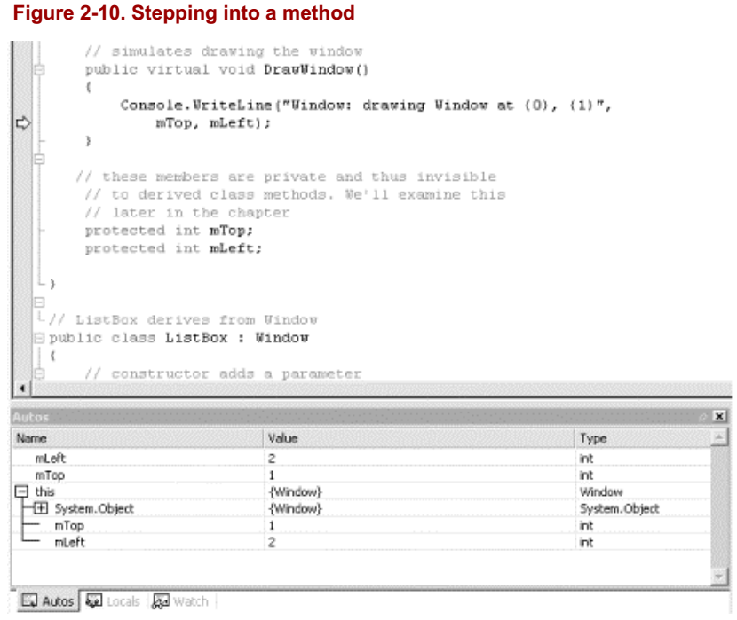
Figure 2-10

Slide 53
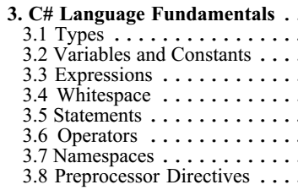
3
C# Language Fundamentals

Slide 54
Intro
Chapter 2 demonstrates a very simple C# program.
Nonetheless, there is sufficient complexity in creating even that little program that some of the pertinent details had to be skipped over.
The current chapter illuminates these details by delving more deeply into the syntax and structure of the C# language itself.
This chapter discusses the type system in C#, drawing a distinction between built-in types (int, bool, etc.) versus user-defined types (types you create as classes and interfaces).
The chapter also covers programming fundamentals such as how to create and use variables and constants.
It then goes on to introduce enumerations, strings, identifiers, expressions, and statements.
The second part of the chapter explains and demonstrates the use of branching, using the if, switch, while, do...while, for, and foreach statements.
Also discussed are operators, including the assignment, logical, relational, and mathematical operators.
This is followed by an introduction to namespaces and a short tutorial on the C# precompiler.

Slide 55
Intro |
Although C# is principally concerned with the creation and manipulation of objects, it is best to start with the fundamental building blocks: the elements from which objects are created.
These include the built-in types that are an intrinsic part of the C# language as well as the syntactic elements of C#.

Slide 56
Types
C# is a strongly typed language.
In a strongly typed language you must declare the type of each object you create (e.g., integers, floats, strings, windows, buttons, etc.) and the compiler will help you prevent bugs by enforcing that only data of the right type is assigned to those objects.
The type of an object signals to the compiler the size of that object (e.g., int indicates an object of 4 bytes) and its capabilities (e.g., buttons can be drawn, pressed, and so forth).
Like C++ and Java, C# divides types into two sets:
intrinsic (built-in) types that the language offers
user-defined types that the programmer defines
C# also divides the set of types into two other categories:
value types
reference types
The principal difference between value and reference types is the manner in which their values are stored in memory.

Slide 57
Types |
A value type holds its actual value in memory allocated on the stack (or it is allocated as part of a larger reference type object).
The address of a reference type variable sits on the stack, but the actual object is stored on the heap.
If you have a very large object, putting it on the heap has many advantages.
Chapter 4 discusses the various advantages and disadvantages of working with reference types; the current chapter focuses on the intrinsic value types available in C#.
C# also supports C++ style pointer types, but these are rarely used, and only when working with unmanaged code.
Unmanaged code is created outside of the .NET platform, such as COM objects.
Working with COM objects is discussed in Chapter 22.

Slide 58
Working with Built-in Types
The C# language offers the usual cornucopia of intrinsic (built-in) types one expects in a modern language, each of which maps to an underlying type supported by the .NET Common Language Specification (CLS).
Mapping the C# primitive types to the underlying .NET type ensures that objects created in C# can be used interchangeably with objects created in any other language compliant with the .NET CLS, such as VB.NET.
Each type has a specific and unchanging size. Unlike with C++, a C# int is always 4 bytes because it maps to an Int32 in the .NET CLS.
Table 3-1 lists the built-in value types offered by C#.
In addition to these primitive types, C# has two other value types:
enum (considered later in this chapter)
struct (see Chapter 4)
Chapter 4 also discusses other subtleties of value types, such as forcing value types to act as reference types through a process known as boxing, and that value types do not "inherit."

Slide 59
NOTE
Boolean variables can only have the values true or false.
Integer values do not equate to Boolean values in C# and there is no implicit conversion.

Slide 60
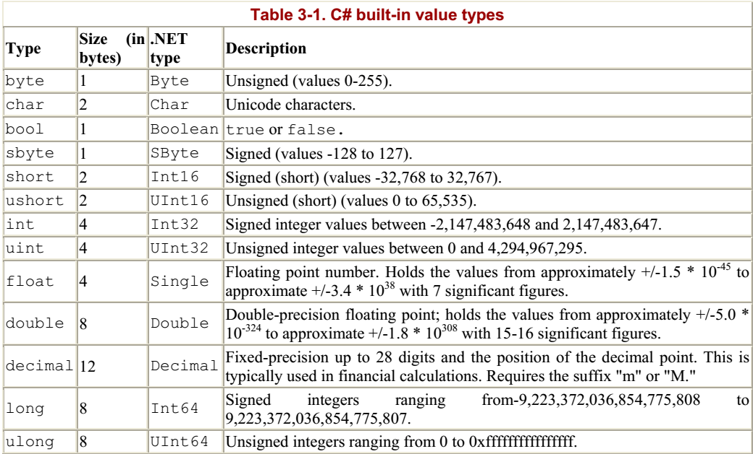
Table 3-1

Slide 61
The Stack and the Heap
A stack is a data structure used to store items on a last-in first-out basis (like a stack of dishes at the buffet line in a restaurant).
The stack refers to an area of memory supported by the processor, on which the local variables are stored.
In C#, value types (e.g., integers) are allocated on the stack -- an area of memory is set aside for their value, and this area is referred to by the name of the variable.
Reference types (e.g., objects) are allocated on the heap.
When an object is allocated on the heap its address is returned, and that address is assigned to a reference.
The garbage collector destroys objects on the stack sometime after the stack frame they are declared within ends.
Typically a stack frame is defined by a function.
Thus, if you declare a local variable within a function (as explained later in this chapter) the object will be marked for garbage collection after the function ends.
Objects on the heap are garbage collected sometime after the final reference to them is destroyed.

Slide 62
Choosing a built-in type
Typically you decide which size integer to use (short, int, or long) based on the magnitude of the value you want to store.
For example, a ushort can only hold values from 0 through 65,535, while a uint can hold values from 0 through 4,294,967,295.
That said, memory is fairly cheap, and programmer time is increasingly expensive; most of the time you'll simply declare your variables to be of type int, unless there is a good reason to do otherwise.
The signed types are the numeric types of choice of most programmers unless the programmer has a good reason to use an unsigned value.
Although you might be tempted to use an unsigned short to double the positive values of a signed short (moving the maximum positive value from 32,767 up to 65,535), it is easier and preferable to use a signed integer (with a maximum value of 2,147,483,647).
It is better to use an unsigned variable when the fact that the value must be positive is an inherent characteristic of the data.
For example, if you had a variable to hold a person's age, you would use an unsigned int because an age cannot be negative.
Float, double, and decimal offer varying degrees of size and precision. For most small fractional numbers, float is fine.

Slide 63

Choosing a built-in type |
Note that the compiler assumes that any number with a decimal point is a double unless you tell it otherwise.
To assign a literal float, follow the number with the letter f. (Assigning values to literals is discussed in detail later in this chapter.)
The char type represents a Unicode character.
char literals can be simple, Unicode, or escape characters enclosed by single quote marks.
For example, A is a simple character while \u0041 is a Unicode character.
Escape characters are special two-character tokens in which the first character is a backslash. For example, \t is a horizontal tab.
The common escape characters are shown in Table 3-2.

Slide 64
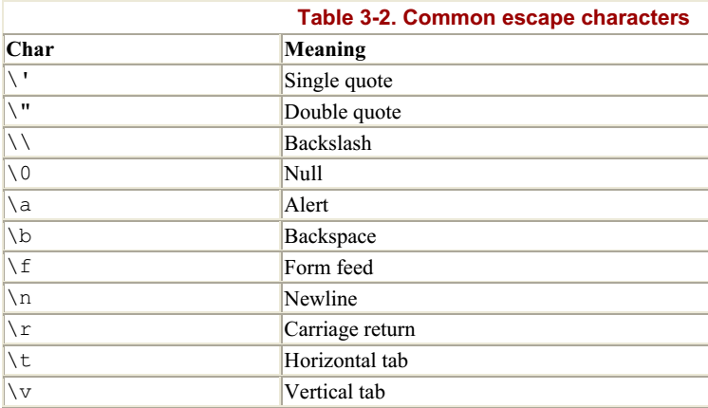
Table 3-2

Slide 65
Converting built-in types

Slide 66
Variables and Constants

Slide 67

Expressions
Statements that evaluate to a value are called expressions.
You may be surprised how many statements do evaluate to a value.
For example, an assignment such as:
is an expression; it evaluates to the value assigned, which, in this case, is 57.
Note that the preceding statement assigns the value 57 to the variable myVariable.
The assignment operator (=) does not test equality; rather it causes whatever is on the right side (57) to be assigned to whatever is on the left side (myVariable).
All of the C# operators (including assignment and equality) are discussed later in this chapter (see "Operators").
Because myVariable = 57 is an expression that evaluates to 57, it can be used as part of another assignment operator, such as:

Slide 68

Expressions |
What happens in this statement is that the literal value 57 is assigned to the variable myVariable.
The value of that assignment (57) is then assigned to the second variable, mySecondVariable.
Thus, the value 57 is assigned to both variables.
You can thus initialize any number of variables to the same value with one statement:

Slide 69
Whitespace

Slide 70
Statements

Slide 71
Operators

Slide 72
Namespaces

Slide 73
Preprocessor Directives
In the examples you've seen so far, you've compiled your entire program whenever you compiled any of it.
At times, however, you might want to compile only parts of your program -- for example, depending on whether you are debugging or building your production code.
Before your code is compiled, another program called the preprocessor runs and prepares your program for the compiler.
The preprocessor examines your code for special preprocessor directives, all of which begin with the pound sign (#).
These directives allow you to define identifiers and then test for their existence.

Slide 74
Defining Identifiers
#define DEBUG defines a preprocessor identifier, DEBUG.
Although other preprocessor directives can come anywhere in your code, identifiers must be defined before any other code, including using statements.
You can test whether DEBUG has been defined with the #if statement.
Thus, you can write the code as shown in Listing P-1.
When the preprocessor runs, it sees the #define statement and records the identifier DEBUG.
The preprocessor skips over your normal C# code and then finds the #if - #else - #endif block.
The #if statement tests for the identifier DEBUG, which does exist, and so the code between #if and #else is compiled into your program -- but the code between #else and #endif is not compiled.
That code does not appear in your assembly at all; it is as if it were left out of your source code.
Had the #if statement failed -- that is, if you had tested for an identifier that did not exist -- the code between #if and #else would not be compiled, but the code between #else and #endif would be compiled.
NOTE: Any code not surrounded by #if - #endif is not affected by the preprocessor and is compiled into your program.

Slide 75
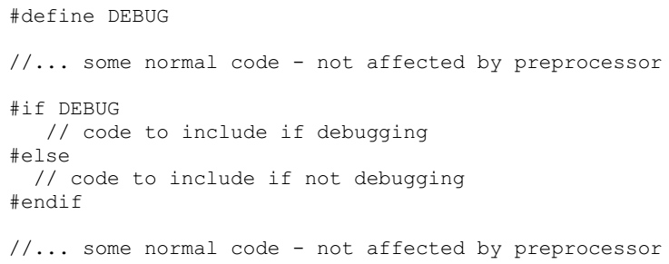
Listing P-1

Slide 76
Undefining Identifiers
Undefine an identifier with #undef.
The preprocessor works its way through the code from top to bottom, so the identifier is defined from the #define statement until the #undef statement, or until the program ends.
Thus if you write the code as shown in Listing P-2.
The first #if will succeed (DEBUG is defined), but the second will fail (DEBUG has been undefined).

Slide 77
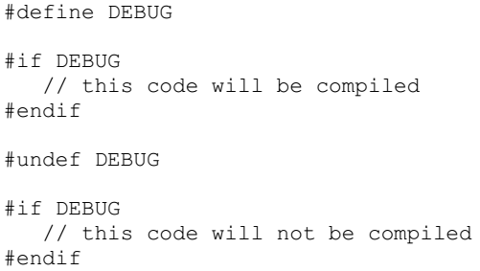
Listing P-2

Slide 78
#if, #elif, #else, and #endif
There is no switch statement for the preprocessor, but the #elif and #else directives provide great flexibility.
The #elif directive allows the else-if logic of "if DEBUG then action one, else if TEST then action two, else action three“ - Listing P-3.
In this example the preprocessor first tests to see if the identifier DEBUG is defined.
If it is, the code between #if and #elif will be compiled, and the rest of the code until #endif, will not be compiled.
If (and only if) DEBUG is not defined, the preprocessor next checks to see if TEST is defined. Note that the preprocessor will not check for TEST unless DEBUG is not defined.
If TEST is defined, the code between the #elif and the #else directives will be compiled.
If it turns out that neither DEBUG nor TEST is defined, the code between the #else and the #endif statements will be compiled.

Slide 79
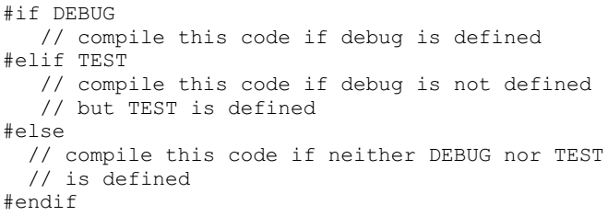
Listing P-3

Slide 80
#region
The #region preprocessor directive marks an area of text with a comment.
The principal use of this preprocessor directive is to allow tools such as Visual Studio .NET to mark off areas of code and collapse them in the editor with only the region's comment showing.
For example, when you create a Windows application (covered in Chapter 13), Visual Studio .NET creates a region for code generated by the designer.
When the region is expanded it looks like Figure 3-1. (Note: I've added the rectangle and highlighting to make it easier to find the region.)
You can see the region marked by the #region and #endregion preprocessor directives.
When the region is collapsed, however, all you see is the region comment (Windows Form Designer generated code), as shown in Figure 3-2.

Slide 81
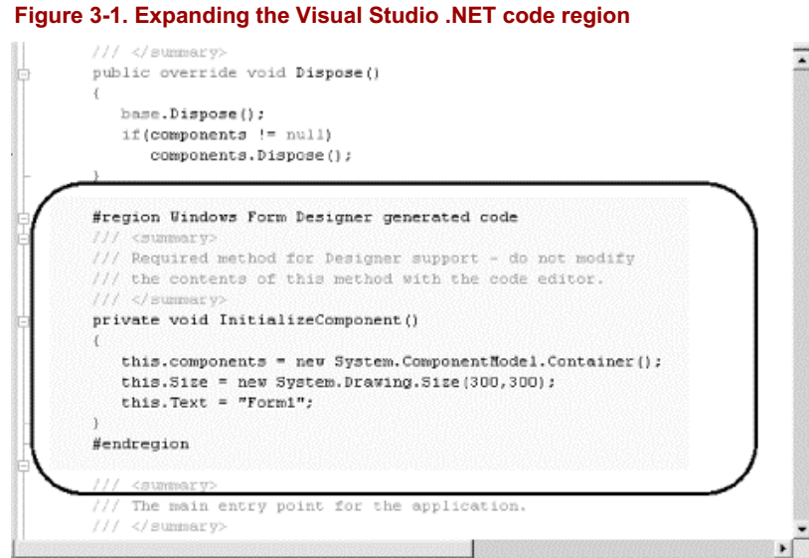
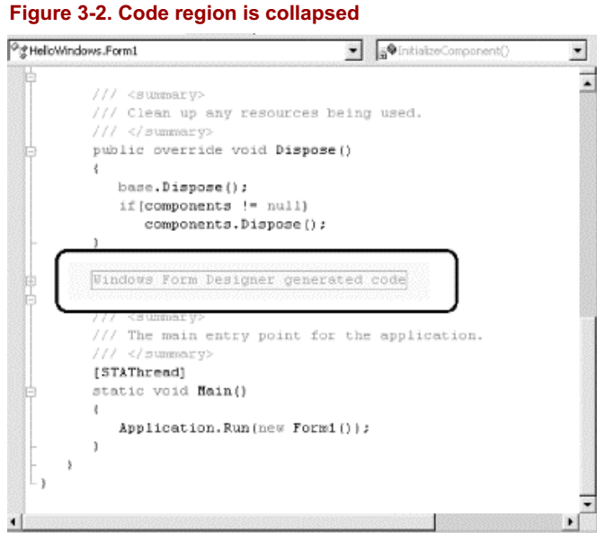
Figure 3-1 || 3-2

Slide 82
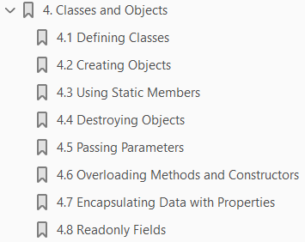
4
Classes and Objects

Slide 83
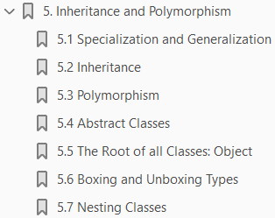
5
Inheritance and Polymorphism

Slide 84
Intro
The previous chapter demonstrates how to create new types by declaring classes.
The current chapter explores the relationship among objects in the real world and how to model these relationships in your code.
This chapter focuses on specialization, which is implemented in C# through inheritance.
This chapter also explains how instances of more specialized classes can be treated as if they were instances of more general classes, a process known as polymorphism.
This chapter ends with a consideration of sealed classes, which cannot be specialized, as well as abstract classes, which exist only to be specialized, and a discussion of the root of all classes, the class Object.

Slide 85
Specialization and Generalization

Slide 86
Specialization and Generalization

Slide 87
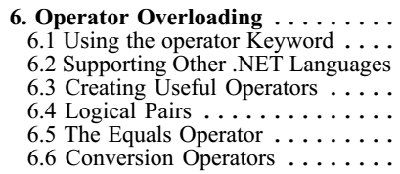
6
Operator Overloading

Slide 88
Intro
It is a design goal of C# that user-defined classes have all the functionality of built-in types.
For example, suppose you have defined a type to represent fractions.
Ensuring that this class has all the functionality of the built-in types means that you must be able to perform arithmetic on instances of your fractions (e.g., add two fractions, multiply, etc.) and convert fractions to and from built-in types such as integer (int).
You could, of course, implement methods for each of these operations and invoke them by writing statements such as:
Although this will work, it is ugly and not how the built-in types are used. It would be much better to write:
Statements like this are intuitive and consistent with how built-in types, such as int, are added.
In this chapter you will learn techniques for adding standard operators to your user-defined types.
You will also learn how to add conversion operators so that your user-defined types can be implicitly and explicitly converted to other types.

Slide 89
Using the operator Keyword
In C#, operators are static methods whose return values represent the result of an operation and whose parameters are the operands.
When you create an operator for a class you say you have "overloaded" that operator, much as you might overload any member method.
Thus, to overload the addition operator (+) you would write:
It is my convention to name the parameters lhs and rhs.
The parameter name lhs stands for "lefthand side" and reminds me that the first parameter represents the lefthand side of the operation. Similarly, rhs stands for "righthand side.“
The C# syntax for overloading an operator is to write the word operator followed by the operator to overload.
The operator keyword is a method modifier.
Thus, to overload the addition operator (+), write operator+.

Slide 90
Using the operator Keyword |
When you write:
the overloaded + operator is invoked, with the first Fraction passed as the first argument, and the second Fraction passed as the second argument. When the compiler sees the expression:
it translates that expression into:
The result is that a new Fraction is returned, which in this case is assigned to the Fraction object named theSum.

Slide 91
Supporting Other .NET Languages
C# provides the ability to overload operators for your classes, even though this is not, strictly speaking, in the Common Language Specification (CLS).
Other .NET languages, such as VB.NET, might not support operator overloading, and it is important to ensure that your class supports the alternative methods that these other languages might call to create the same effect.
Thus, if you overload the addition operator (+), you might also want to provide an add( ) method that does the same work.
Operator overloading ought to be a syntactic shortcut, not the only path for your objects to accomplish a given task.

Slide 92
Creating Useful Operators
Operator overloading can make your code more intuitive and enable it to act more like the built-in types.
It can also make your code unmanageable, complex, and obtuse if you break the common idiom for the use of operators.
Resist the temptation to use operators in new and idiosyncratic ways.
For example, although it might be tempting to overload the increment operator (++) on an employee class to invoke a method incrementing the employee's pay level, this can create tremendous confusion for clients of your class.
It is best to use operator overloading sparingly, and only when its meaning is clear and consistent with how the built-in classes operate.

Slide 93
Logical Pairs
It is quite common to overload the equals operator (==) to test whether two objects are equal (however equality might be defined for your object).
C# insists that if you overload the equals operator, you must also overload the not-equals operator (!= ).
Similarly, the less-than (<) and greater-than (>) operators must be paired, as must the less-than or equals (<=) and greater-than or equals (>=) operators.

Slide 94
The Equals Operator
If you overload the equals operator (==), it is recommended that you also override the virtual Equals( ) method provided by object and route its functionality back to the equals operator.
This allows your class to be polymorphic and provides compatibility with other .NET languages that do not overload operators (but do support method overloading).
The FCL classes will not use the overloaded operators but will expect your classes to implement the underlying methods.
Thus, for example, ArrayList expects you to implement Equals( ).
The object class implements the Equals( ) method with this signature:
By overriding this method, you allow your Fraction class to act polymorphically with all other objects.
Inside the body of Equals( ), you will need to ensure that you are comparing with another Fraction, and if so you can pass the implementation along to the equals operator definition that you've written Listing 6-1.
The is operator is used to check whether the runtime type of an object is compatible with the operand (in this case, Fraction).
Thus o is Fraction will evaluate true if o is in fact a type compatible with Fraction.

Slide 95
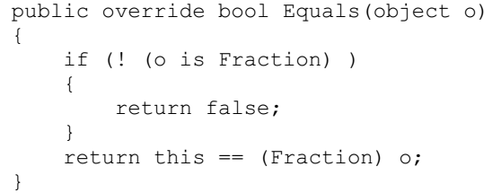
Listing 6-1

Slide 96
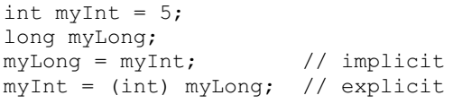
Conversion Operators
C# converts int to long implicitly, and allows you to convert long to int explicitly.
The conversion from int to long is implicit because you know that any int will fit into the memory representation of a long.
The reverse operation, from long to int, must be explicit (using a cast) because it is possible to lose information in the conversion:
You must have the same functionality for your fractions.
Given an int, you can support an implicit conversion to a fraction because any whole value is equal to that value over 1 (e.g., 15==15/1).
Given a fraction, you might want to provide an explicit conversion back to an integer, understanding that some value might be lost.
Thus, you might convert 9/4 to the integer value 2.

Slide 97
Implicit, Explicit Keywords
The keyword implicit is used when the conversion is guaranteed to succeed and no information will be lost; otherwise explicit is used.
Example 6-1 illustrates how you might implement implicit and explicit conversions, and some of the operators of the Fraction class. (Although I've used Console.WriteLine to print messages illustrating which method we're entering, the better way to pursue this kind of trace is with the debugger. You can place a breakpoint on each of the test statements, and then step into the code, watching the invocation of the constructors as they occur.)
When you compile this example, it will generate some warnings because GetHashCode( ) is not implemented (see Chapter 9).

Slide 98
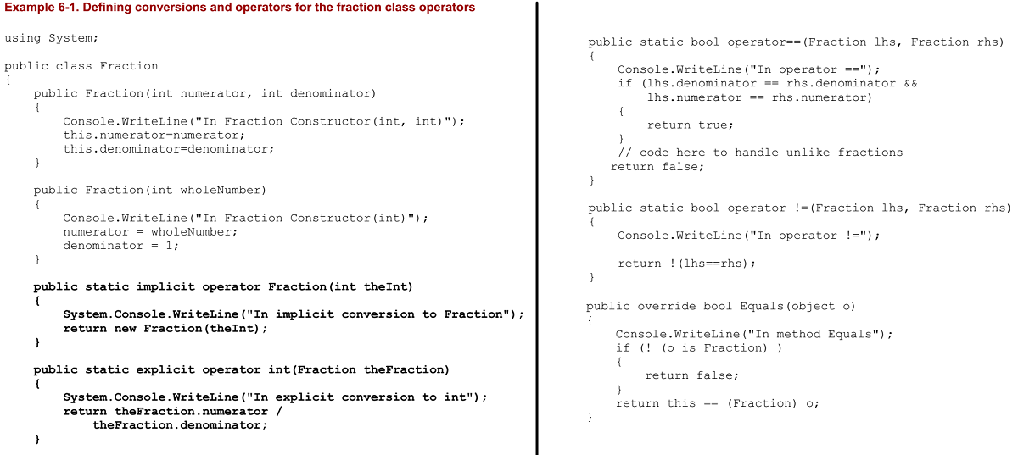
Example 6-1

Slide 99
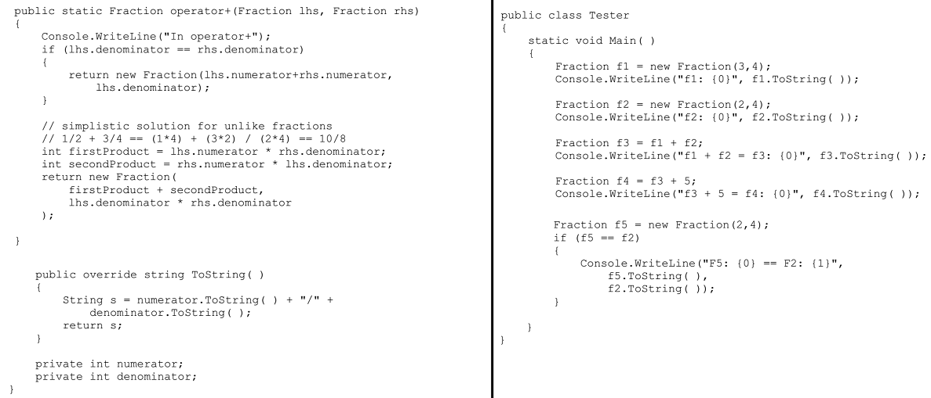
Example 6-1 |

Slide 100

7
Structs

Slide 101
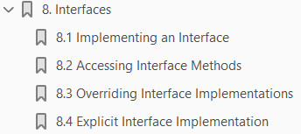
8
Interfaces

Slide 102
Intro
An interface is a contract that guarantees to a client how a class or struct will behave.
When a class implements an interface, it tells any potential client "I guarantee I'll support the
Methods
Properties
events, and
Indexers
of the named interface.“
(See Chapter 4 for information about methods and properties; see Chapter 12 for info about events, and see Chapter 9 for coverage of indexers.)
An interface offers an alternative to an abstract class for creating contracts among classes and their clients.
These contracts are made manifest using the interface keyword, which declares a reference type that encapsulates the contract.
Syntactically, an interface is like a class that has only abstract methods.
An abstract class serves as the base class for a family of derived classes, while interfaces are meant to be mixed in with other inheritance trees.

Slide 103
Intro |
When a class implements an interface, it must implement all the methods of that interface; in effect the class says "I agree to fulfill the contract defined by this interface.“
Inheriting from an abstract class implements
the is-a relationship
introduced in Chapter 5.
Implementing an interface defines a different relationship that we've not seen until now:
the implements relationship
These two relationships are subtly different.
A car is a vehicle, but it might implement the CanBeBoughtWithABigLoan capability (as can a house, for example).
In this chapter, you will learn how to create, implement, and use interfaces.
You'll learn how to implement multiple interfaces and how to combine and extend interfaces, as well as how to test whether a class has implemented an interface.

Slide 104
Mix Ins
In Somerville, Massachusetts, there was, at one time, an ice cream parlor where you could have candies and other goodies "mixed in" with your chosen ice cream flavor.
This seemed like a good metaphor to some of the object-oriented pioneers from nearby MIT who were working on the fortuitously named SCOOPS programming language.
They appropriated the term "mix in" for classes that mixed in additional capabilities.
These mix-in or capability classes served much the same role as interfaces do in C#.

Slide 105
Implementing an Interface

Slide 106
Accessing Interface Methods

Slide 107
Overriding Interface Implementations

Slide 108
Explicit Interface Implementations

Slide 109
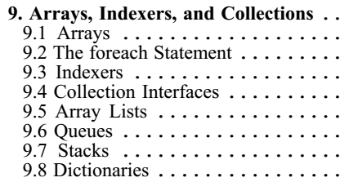
9
Arrays, Indexers, and Collections

Slide 110
Intro
The .NET Framework provides a rich suite of collection classes, including Array, ArrayList, NameValueCollection, StringCollection, Queue, Stack, and BitArray.
The simplest collection is the Array, the only collection type for which C# provides built-in support.
In this chapter you will learn to work with single, multidimensional, and jagged arrays.
You will also be introduced to indexers, a bit of C# syntactic sugar that makes it easier to access class properties, as though the class were indexed like an array.
The .NET Framework provides a number of interfaces, such as IEnumerable and ICollection, whose implementation provides you with standard ways to interact with collections.
In this chapter you will see how to work with the most essential of these.
The chapter concludes with a tour of commonly used .NET collections, including ArrayList, Hashtable, Queue, and Stack.

Slide 111
Arrays

Slide 112
The foreach Statement

Slide 113
Indexers
There are times when it is desirable to access a collection within a class as though the class itself were an array.
For example, suppose you create a list box control named myListBox that contains a list of strings stored in a one-dimensional array, a private member variable named myStrings.
A list box control contains member properties and methods in addition to its array of strings.
However, it would be convenient to be able to access the list box array with an index, just as if the list box were an array.
For example, such a property would permit statements like the following:
An indexer is a C# construct that allows you to access collections contained by a class using the familiar [ ] syntax of arrays.
An indexer is a special kind of property and includes get( ) and set( ) methods to specify its behavior.

Slide 114
Syntax
You declare an indexer property within a class using the following syntax:
The return type determines the type of object that will be returned by the indexer, while the type argument specifies what kind of argument will be used to index into the collection that contains the target objects.
Although it is common to use integers as index values, you can index a collection on other types as well, including strings.
You can even provide an indexer with multiple parameters to create a multidimensional array!
The this keyword is a reference to the object in which the indexer appears.
As with a normal property, you also must define get( ) and set( ) methods, which determine how the requested object is retrieved from or assigned to its collection.
Example 9-9 declares a list box control (ListBoxTest), which contains a simple array (myStrings) and a simple indexer for accessing its contents.

Slide 115
NOTE
The index operator cannot be overloaded in C#, which provides the indexer in its place.
Because you cannot know how many strings will be added, use the keyword params, as described earlier in this chapter.

Slide 116
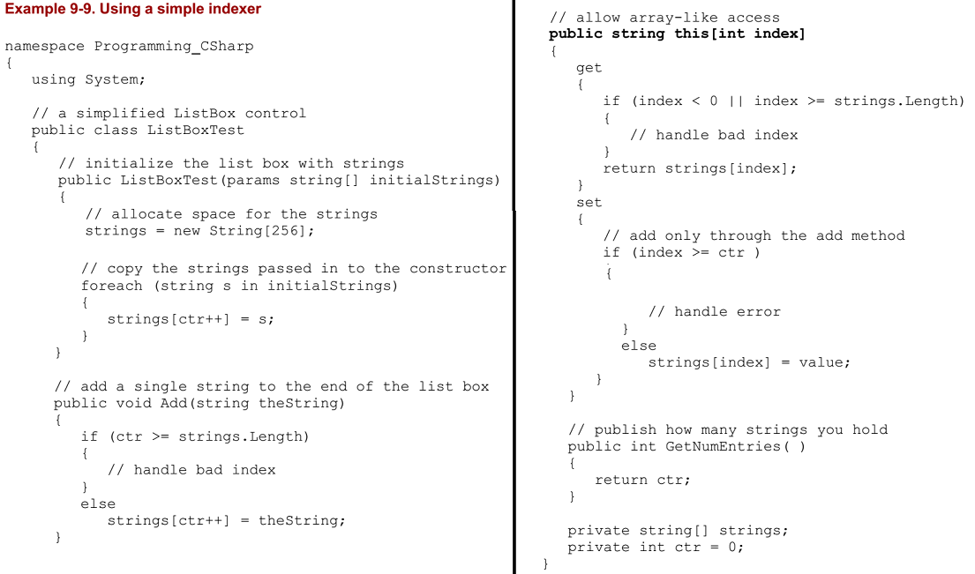
Example 9-9

Slide 117
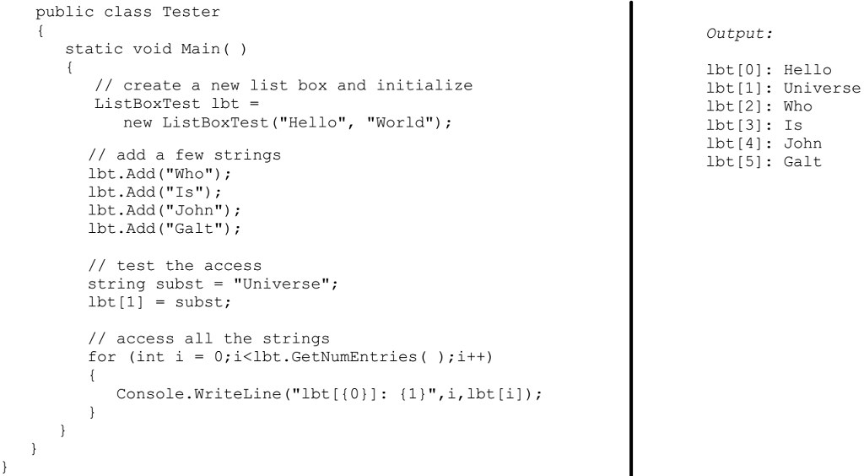
Example 9-9 |

Slide 118


Explanation
To keep Example 9-9 simple, strip the list box control down to the few features we care about.
The listing ignores everything having to do with being a user control and focuses only on the list of strings the list box maintains and methods for manipulating them.
In a real application, of course, these are a small fraction of the total methods of a list box, whose principal job is to display the strings and enable user choice.
The first thing to notice is the two private members:
In this program, the list box maintains a simple array of strings: strings. Again, in a real list box you might use a more complex and dynamic container, such as a hash table (described later in this chapter).
The member variable ctr will keep track of how many strings have been added to this array. Initialize the array in the constructor with the statement:
The remainder of the constructor adds the parameters to the array. Again, for simplicity, simply add new strings to the array in the order received.

Slide 119

Explanation |
The Add( ) method of ListBoxTest does nothing more than append a new string to the internal array.
The key method of ListBoxTest, however, is the indexer.
An indexer is unnamed, so use the this keyword:
The syntax of the indexer is very similar to that for properties.
There is either a get( ) method, a set( ) method, or both.
Thus, if you write:
the compiler will call the indexer set( ) method on your object and pass in the string Hello World as an implicit parameter named value.

Slide 120

Indexers and Assignment
In Example 9-9, you cannot assign to an index that does not have a value.
Thus, if you write:
you would trigger the error handler in the set( ) method, which would note that the index you've passed in (10) is larger than the counter (6).
Of course, you can use the set( ) method for assignment; you simply have to handle the indexes you receive.
To do so, you might change the set( ) method to check the Length of the buffer rather than the current value of counter.
If a value was entered for an index that did not yet have a value, you would update ctr Listing 9-A.
This allows you to create a "sparse" array in which you can assign to offset 10 without ever having assigned to offset 9.
Thus, you can write the aforementioned statement.

Slide 121
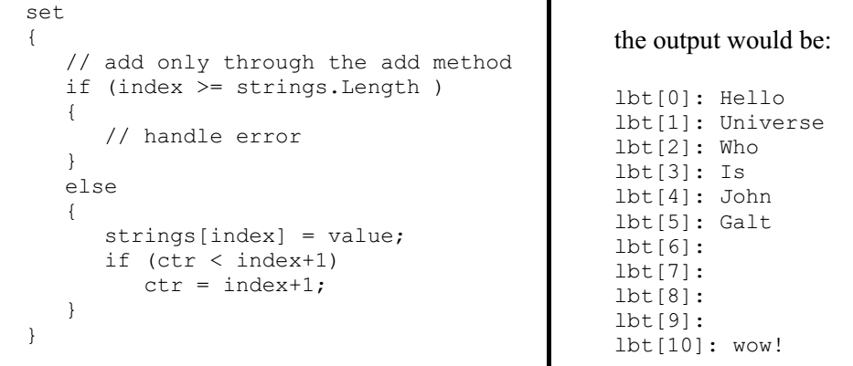
Example 9-A

Slide 122
Indexing on Other Values
C# does not require that you always use an integer value as the index to a collection.
When you create a custom collection class and create your indexer, you are free to create indexers that index on strings and other types.
In fact, the index value can be overloaded so that a given collection can be indexed, for example, by an integer value or by a string value, depending on the needs of the client.
In the case of our list box, we might want to be able to index into the list box based on a string. Example 9-10 illustrates a string index.
The indexer calls findString( ), which is a helper method that returns a record based on the value of the string provided.
Notice that the overloaded indexer and the indexer from Example 9-9 are able to coexist.
Example 9-10 is identical to Example 9-9 except for the addition of an overloaded indexer, which can match a string, and the method findString, created to support that index.
The findString method simply iterates through the strings held in myStrings until it finds a string that starts with the target string we use in the index.
If found, it returns the index of that string; otherwise it returns the value -1.

Slide 123
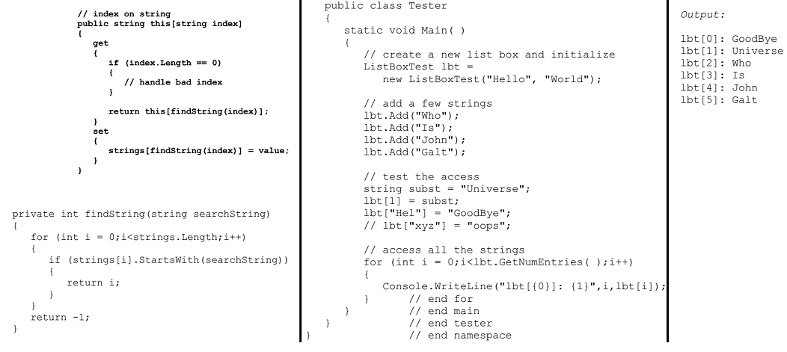
Example 9-10

Slide 124
Collection Interfaces

Slide 125
Array Lists

Slide 126
Queues

Slide 127
Stacks

Slide 128
Dictionaries

Slide 129

10
Strings and Regular Expressions

Slide 130
Intro
There was a time when people thought of computers exclusively as manipulating numeric values. Early computers were first used to calculate missile trajectories, and programming was taught in the math department of major universities.
Today, most programs are concerned more with strings of characters than with strings of numbers.
Typically these strings are used for word processing, document manipulation, and creation of web pages. C# provides built-in support for a fully functional string type.
More importantly, C# treats strings as objects that encapsulate all the manipulation, sorting, and searching methods normally applied to strings of characters.
Complex string manipulation and pattern matching is aided by the use of regular expressions.
C# combines the power and complexity of regular expression syntax, originally found only in string manipulation languages such as awk and Perl, with a fully object-oriented design.
In this chapter, you will learn to work with the C# string type and the .NET Framework System.String class that it aliases.
You will see how to extract substrings, manipulate and concatenate strings, and build new strings with the StringBuilder class.
In addition, you will learn how to use the RegEx class to match strings based on complex regular expressions.

Slide 131
Strings
C# treats strings as first-class types that are flexible, powerful, and easy to use.
Each string object is an immutable sequence of Unicode characters.
In other words, methods that appear to change the string actually return a modified copy; the original string remains intact.
When you declare a C# string using the string keyword, you are in fact declaring the object to be of the type System.String, one of the built-in types provided by the .NET Framework Class Library.
A C# string type is a System.String type, and we will use the names interchangeably throughout the chapter.
The declaration of the System.String class is:
This declaration reveals that the class is sealed, meaning that it is not possible to derive from the string class.
The class also implements four system interfaces -- IComparable, ICloneable, IConvertible, and IEnumerable -- which dictate functionality that System.String shares with other classes in the .NET Framework.
As seen in Chapter 9, the IComparable interface is implemented by types whose values can be ordered.

Slide 132
Strings |
Strings, for example, can be alphabetized; any given string can be compared with another string to determine which should come first in an ordered list.
IComparable classes implement the CompareTo method.
IEnumerable, also discussed in Chapter 9, lets you use the foreach construct to enumerate a string as a collection of chars.
ICloneable objects can create new instances with the same value as the original instance.
In this case, it is possible to clone a string to produce a new string with the same values (characters) as the original.
ICloneable classes implement the Clone( ) method.
IConvertible classes provide methods to facilitate conversion to other primitive types such as ToInt32( ), ToDouble( ), ToDecimal( ), etc.

Slide 133
Creating Strings

Slide 134
The ToString Method

Slide 135
Manipulating Strings

Slide 136
Finding Substrings

Slide 137
Splitting Strings

Slide 138
Manipulating Dynamic Strings

Slide 139
Regular Expressions
Regular expressions are a powerful language for describing and manipulating text.
A regular expression is applied to a string -- that is, to a set of characters. Often that string is an entire text document.
The result of applying a regular expression to a string is either to return a substring, or to return a new string representing a modification of some part of the original string.
Remember that strings are immutable and so cannot be changed by the regular expression.
By applying a properly constructed regular expression to the following string:
you can return any or all of its substrings (e.g., Liberty or One), or modified versions of its substrings (e.g., LIBeRtY or OnE).
What the regular expression does is determined by the syntax of the regular expression itself.
A regular expression consists of two types of characters:
Literals
Metacharacters

Slide 140

Regular Expressions |
A literal is a character you wish to match in the target string.
A metacharacter is a special symbol that acts as a command to the regular expression parser.
The parser is the engine responsible for understanding the regular expression.
For example, if you create a regular expression:
this will match any substring with the letters "From," "To," "Subject," or "Date," so long as those letters start a new line (^) and end with a colon (:).
The caret (^) in this case indicates to the regular expression parser that the string you're searching for must begin a new line.
The letters "From" and "To" are literals, and the metacharacters left and right parentheses ( (, ) ) and vertical bar (|) are all used to group sets of literals and indicate that any of the choices should match. (Note that ^ is a metacharacter as well, used to indicate the start of the line.)
Thus you would read it as follows: "match any string that begins a new line followed by any of the four literal strings From, To, Subject, or Date followed by a colon.“

Slide 141
Using Regular Expressions: Regex
The .NET Framework provides an object-oriented approach to regular expression matching and replacement.
The Base Class Library namespace System.Text.RegularExpressions is the home to all the .NET Framework objects associated with regular expressions.
The central class for regular expression support is Regex, which represents
an immutable,
compiled regular expression
Although instances of Regex can be created, the class also provides a number of useful static methods.
The use of Regex is illustrated in Example 10-5.
One of the overloaded constructors for Regex takes a regular expression string as its parameter.
This is a bit confusing.
In the context of a C# program, which is the regular expression? Is it the text passed in to the constructor, or the Regex object itself?
It is true that the text string passed to the constructor is a regular expression in the traditional sense of the term.
From an object-oriented C# point of view, however, the argument to the constructor is just a string of characters; it is theRegex that is the regular expression object.

Slide 142
Using Regular Expressions: Regex |
The rest of the program proceeds like the earlier Example 10-4, except that rather than calling Split( ) on string s1, the Split( ) method of Regex is called.
Regex.Split( ) acts in much the same way as String.Split( ), returning an array of strings as a result of matching the regular expression pattern within theRegex.
Regex.Split( ) is overloaded.
The simplest version is called on an instance of Regex, as shown in Example 10-5.
There is also a static version of this method, which takes a string to search and the pattern to search with, as illustrated in Example 10-6.
Example 10-6 is identical to Example 10-5, except that the latter example does not instantiate an object of type Regex.
Instead, Example 10-6 uses the static version of Split( ), which takes two arguments: a string to search for and a regular expression string that represents the pattern to match.
The instance method of Split( ) is also overloaded with versions that limit the number of times the split will occur and also determine the position within the target string where the search will begin.

Slide 143
NOTE
C#'s regular expressions are based on Perl5 regexp, including lazy quantifiers (??, *?, +?, {n,m}?), positive and negative look ahead, and conditional evaluation.

Slide 144
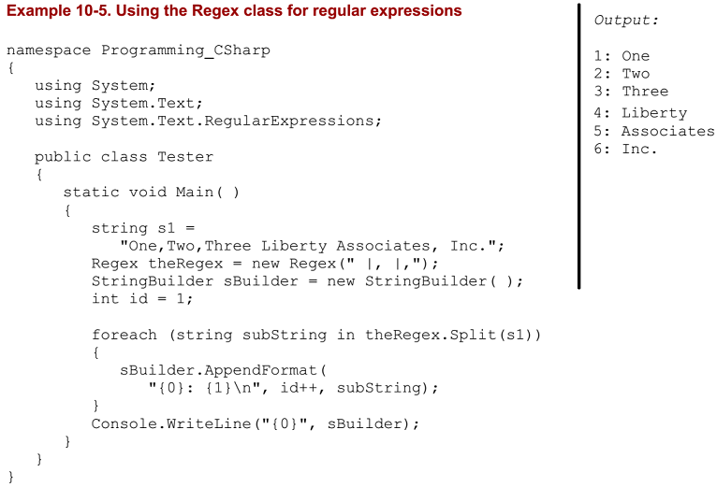
Example 10-5

Slide 145
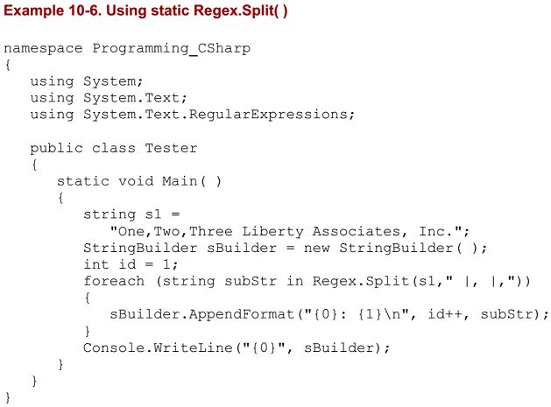
Example 10-6

Slide 146
Using Regex Match Collections
Two additional classes in the .NET RegularExpressions namespace allow you to search a string repeatedly, and to return the results in a collection.
The collection returned is of type MatchCollection, which consists of zero or more Match objects.
Two important properties of a Match object are its length and its value, each of which can be read as illustrated in Example 10-7.
The regular expression:
The string \S finds nonwhitespace, and the plus sign(+) indicates one or more.
The string \s (note lowercase) indicates whitespace.
Thus, together, this string looks for any nonwhitespace characters followed by whitespace.

Slide 147
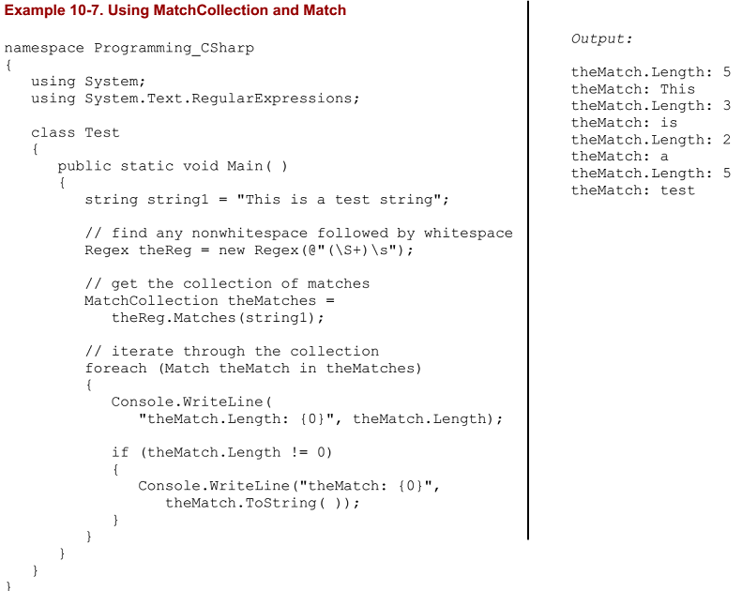
Example 10-7

Slide 148
Using Regex Groups
It is often convenient to group subexpression matches together so that you can parse out pieces of the matching string.
For example, you might want to match on IP addresses and group all IP addresses found anywhere within the string.
The Group class allows you to create groups of matches based on regular expression syntax, and represents the results from a single grouping expression.
A grouping expression names a group and provides a regular expression; any substring matching the regular expression will be added to the group.
For example, to create an ip group you might write:
The Match class derives from Group, and has a collection called "Groups" that contains all the groups your Match finds.
Creation and use of the Groups collection and Group classes is illustrated in Example 10-8.

Slide 149
Using CaptureCollection

Slide 150
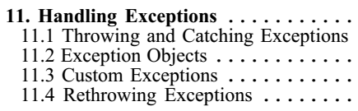
11
Handling Exceptions

Slide 151

12
Delegates and Events

Slide 152
Intro
When a head of state dies, the president of the United States typically does not have time to attend the funeral personally.
Instead, he dispatches a delegate.
Often this delegate is the vice president, but sometimes the VP is unavailable and the president must send someone else, such as the secretary of state or even the first lady.
He doesn't want to "hardwire" his delegated authority to a single person; he might delegate this responsibility to anyone who is able to execute the correct international protocol.
The president defines in advance what authority will be delegated (attend the funeral), what parameters will be passed (condolences, kind words), and what value he hopes to get back (good will).
He then assigns a particular person to that delegated responsibility at "runtime" as the course of his presidency progresses.
In programming, you are often faced with situations where you need to execute a particular action, but you don't know in advance which method, or even which object, you'll want to call upon to execute that action.
For example, a button might know that it must notify some object when it is pushed, but it might not know which object or objects need to be notified.
Rather than wiring the button to a particular object, you will connect the button to a delegate and then resolve that delegate to a particular method when the program executes.

Slide 153
Intro |
In the early, dark, and primitive days of computing, a program would begin execution and then proceed through its steps until it completed.
If the user was involved, the interaction was strictly controlled and limited to filling in fields.
Today's Graphical User Interface (GUI) programming model requires a different approach, known as event-driven programming.
A modern program presents the user interface and waits for the user to take an action.
The user might take many different actions, such as choosing among menu selections, pushing buttons, updating text fields, clicking icons, and so forth.
Each action causes an event to be raised.
Other events can be raised without direct user action, such as events that correspond to timer ticks of the internal clock, email being received, file-copy operations completing, etc.
An event is the encapsulation of the idea that "something happened" to which the program must respond.
Events and delegates are tightly coupled concepts because flexible event handling requires that the response to the event be dispatched to the appropriate event handler.

Slide 154
Intro ||
An event handler is typically implemented in C# as a delegate.
Delegates are also used as callbacks so that one class can say to another "do this work and when you're done, let me know.“
This second usage will be covered in detail in Chapter 21.
Delegates can also be used to specify methods that will only become known at runtime.
This topic is developed in the following sections.

Slide 155
Delegates
In C#, delegates are first-class objects, fully supported by the language.
Technically, a delegate is a reference type used to encapsulate a method with a specific signature and return type.
You can encapsulate any matching method in that delegate. (In C++ and many other languages, you can accomplish this requirement with function pointers and pointers to member functions. Unlike function pointers, delegates are object-oriented and type-safe.)
A delegate is created with the delegate keyword, followed by a return type and the signature of the methods that can be delegated to it, as in the following:
This declaration defines a delegate named WhichIsFirst, which will encapsulate any method that takes two objects as parameters and returns an int.
Once the delegate is defined, you can encapsulate a member method with that delegate by instantiating the delegate, i.e., passing in a method that matches the return type and signature.

Slide 156
Events

Slide 157
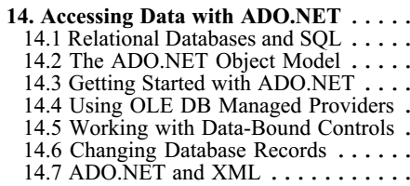
14
Accessing Data with ADO.NET

Slide 158
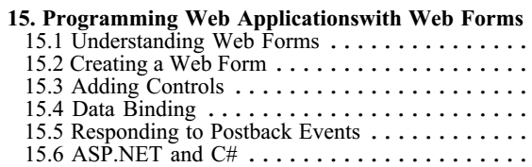
15
Programming Web Applications with Web Forms

Slide 159
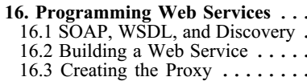
16
Programming Web Services

Slide 160
Intro
.NET Web Services expand on the concept of distributed processing to build components whose methods can be invoked across the Internet.
These components can be built in any .NET language, and they communicate using open protocols that are platform-independent.
For example, a stock exchange server might provide a web service method that takes a stock ticker symbol as a parameter and returns a quote.
An application might combine that service with another service from a different company that also takes a stock symbol but that returns background data about the company.
The application developer can concentrate on adding value to these services, rather than duplicating the same service for his own application.
The list of web services that might be useful to developers and end users seems boundless.
A bookstore might provide a web service that takes an ISBN and returns the price and availability of a title.
A hotel's web service might take a date range and number of guests and return a reservation.
Another web service might take a telephone number and return a name and address.
Yet another might provide information about the weather or shuttle launches.
Microsoft has announced a number of commercial .NET services as part of its .NET My Services initiative.

Slide 161
Intro |
Among these are its Passport service for identifying and authenticating users (see http://www.passport.com/), as well as services for managing storage, notification, appointments, and a host of other applications.
These services, as well as the ones you write, can be integrated with your applications just like any other business object.
In such a world, a single application might draw on and stitch together the services of hundreds of small web services distributed all over the world.
This takes the Web to an entirely new dimension: not only is information retrieved and exchanged, but also methods are invoked and applications are executed.

Slide 162
SOAP, WSDL, and Discovery
What is needed to make web services possible is a simple, universally accepted protocol for exposing, finding, and invoking web service functions.
In 1999, Simple Object Access Protocol (SOAP) was proposed to the World Wide Web Consortium.
SOAP has the advantages of being based on XML and of using standard Internet communications protocols.
SOAP is a lightweight, message-based protocol built on XML, HTTP, and SMTP.
Two other protocols are desirable, but not required, for a client to use a SOAP-enabled web service:
a description of the methods provided by a particular service that can be understood and acted upon by clients
a description of all such services available at a particular site or URL.
The first of these is provided in .NET by the Web Service Description Language (WSDL) protocol, jointly developed by Microsoft, IBM, and others.
Two other protocols have been proposed for discovery: UDDI, a joint effort by a number of companies including IBM and Microsoft, and Discovery, a proprietary offering from Microsoft.
WSDL is an XML schema used to describe the available methods -- the interface -- of a web service.

Slide 163
SOAP, WSDL, and Discovery |
Discovery enables applications to locate and interrogate web service descriptions, a preliminary step for accessing a web service.
It is through the discovery process that web service clients learn that a service exists, what its capabilities are, and how to properly interact with it.
A Discovery (.disco) file provides information to help browsers determine the URLs at any web site at which web services are available.
When a server receives a request for a .disco file, it generates a list of some or all of the URLs at that site that provide web services.

Slide 164
Server-side Support
The plumbing necessary to discover and invoke web services is integrated into the .NET Framework and provided by classes within the System.Web.Services namespace.
Creating a web service requires no special programming on your part; you need only write the implementing code, add the [WebMethod] attribute, and let the server do the rest.
You can read about attributes in detail in Chapter 18.

Slide 165
Client-side Support
You make use of a web service by writing client code that acts as though it were communicating directly with the host server by means of a URL.
However, in reality, the client interacts with a proxy.
The job of the proxy is to represent the server on the client machine, to bundle client requests into SOAP messages that are sent on to the server, and to retrieve the responses that contain the result.
Proxies and the details of dealing with objects on other machines are covered in detail in Chapter 19.

Slide 166
Building a Web Service
To illustrate the techniques used to implement a web service in C# using the services classes of the .NET Framework, build a simple calculator and then make use of its functions over the Web.
Begin by specifying the web service.
To do so, define a class that inherits from System.Web.Services.WebService.
The easiest way to create this class is to open Visual Studio and create a new C# Web Service project.
The default name that Visual Studio provides is WebService1, but you might want to choose something more appropriate.
Visual Studio .NET creates a skeleton web service and even provides a Web Service example method for you to replace with your own code, as shown in Example 16-1.

Slide 167
Creating the Proxy

Slide 168
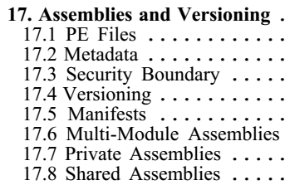
17
Assemblies and Versioning

Slide 169
Intro
The basic unit of .NET programming is the assembly.
An assembly is a collection of files that appears to the user to be a single dynamic link library (DLL) or executable (EXE).
DLLs are collections of classes and methods that are linked into your running program only when they are needed.
Assemblies are the .NET unit of
reuse,
versioning,
Security
deployment
This chapter discusses assemblies in detail, including the architecture and contents of assemblies, private assemblies, and shared assemblies.
In addition to the object code for the application, assemblies contain resources such as .gif files, type definitions for each class you define, as well as metadata about the code and data.
Metadata is explored in detail in Chapter 18.

Slide 170
PE Files
On disk, assemblies are Portable Executable (PE) files.
PE files are not new.
The format of a .NET PE file is exactly the same as a normal Windows PE file.
PE files are implemented as DLLs or EXEs.
Logically (as opposed to physically), assemblies consist of one or more modules.
Note, however, that an assembly must have exactly one entry point -- DLLMain, WinMain, or Main.
DLLMain is the entry point for DLLs,
WinMain is the entry point for Windows applications
Main is the entry point for DOS and Console applications
Modules are created as DLLs and are the constituent pieces of assemblies.
Standing alone, modules cannot be executed; they must be combined into assemblies to be useful.
Deploy and reuse the entire contents of an assembly as a unit.
Assemblies are loaded on demand and will not be loaded if not needed.

Slide 171
Metadata
Metadata is information stored in the assembly that describes the types and methods of the assembly and provides other useful information about the assembly.
Assemblies are said to be self-describing because the metadata fully describes the contents of each module.
Metadata is discussed in detail in Chapter 18.

Slide 172
Security Boundary
Assemblies form security boundaries as well as type boundaries.
That is, an assembly is the scope boundary for the types it contains, and types cannot cross assemblies.
You can, of course, refer to types across assembly boundaries by adding a reference to the required assembly, either in the Integrated Development Environment (IDE) or on the command line, at compile time.
What you cannot do is have the definition of a type span two assemblies.

Slide 173
Versioning
Each assembly has a version number, and versions cannot transcend the boundary of the assembly.
That is, a version can refer only to the contents of a single assembly.
All types and resources within the assembly change versions together.

Slide 174
Manifests
As part of its metadata, every assembly has a manifest.
This describes
what is in the assembly
including identification information (name, version, etc.)
a list of the types and resources in the assembly
a map to connect public types with the implementing code
a list of assemblies referenced by this assembly.
Even the simplest program has a manifest.
You can examine that manifest using ILDasm, which is provided as part of your development environment.
When you open it in ILDasm, the EXE program created by Example 12-3 looks like Figure 17-1.
Notice the manifest (second line from the top). Double-clicking the manifest opens a Manifest window, as shown in Figure 17-2.
This file serves as a map of the contents of the assembly.
You can see in the first line the reference to the mscorlib assembly, which is referenced by this and every .NET application.

Slide 175
Manifests |
The mscorlib assembly is the core library assembly for .NET and is available on every .NET platform.
The next assembly line is a reference to the assembly from Example 12-3.
You can also see that this assembly consists of a single module.
You can ignore the rest of the metadata for now.

Slide 176
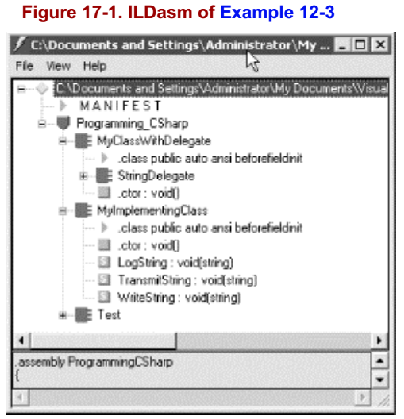
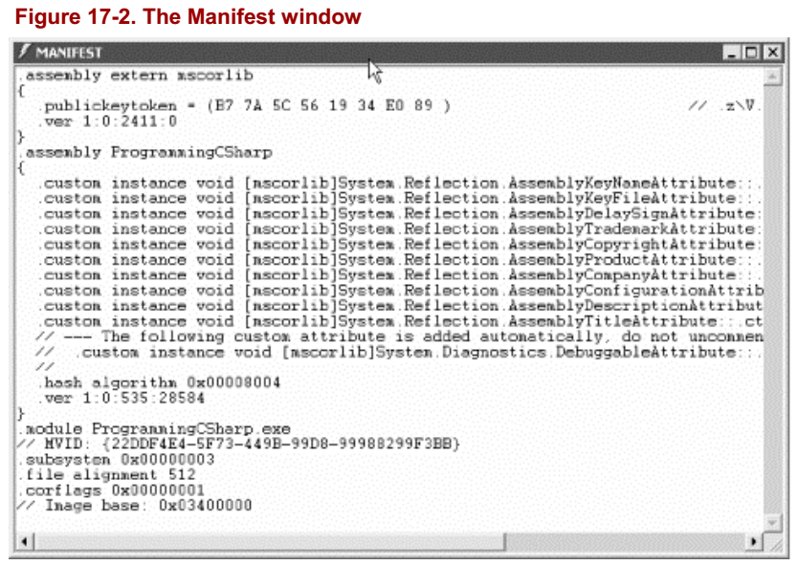
Figure 17-1 || 17-2

Slide 177
Modules in the Manifest
Assemblies can consist of more than one module.
In such a case, the manifest includes a hash code identifying each module to ensure that when the program executes, only the proper version of each module is loaded.
If you have multiple versions of a given module on your machine, the hash code ensures that your program will load properly.
The hash is a numeric representation of the code for the module, and if the code is changed, the hash will not match.

Slide 178
Module Manifests
Each module has a manifest of its own that is separate from the assembly manifest.
The module manifest lists the assemblies referenced by that particular module.
In addition, if the module declares any types, these are listed in the manifest along with the code to implement the module.
A module can also contain resources, such as the images needed by that module.

Slide 179
Other Required Assemblies
The assembly manifest also contains references to other required assemblies.
Each such reference includes the name of the other assembly, the version number and required culture, and optionally, the other assembly's originator.
The originator is a digital signature for the developer or company that provided the other assembly.

Slide 180
NOTE
Culture is an object representing the language and national display characteristics for the person using your program.
It is culture that determines, for example, whether dates are in month/date/year format or date/month/year format.

Slide 181
Multi-Module Assemblies
A single-module assembly has a single file that can be an EXE or DLL file.
This single module contains all the types and implementations for the application.
The assembly manifest is embedded within this module.
A multi-module assembly consists of multiple files (zero or one EXE and zero or more DLL files, though you must have at least one EXE or DLL).
The assembly manifest in this case can reside in a standalone file, or it can be embedded in one of the modules.
When the assembly is referenced, the runtime loads the file containing the manifest and then loads the required modules as needed.

Slide 182
Benefiting from Multi-Module Assemblies
Multi-module assemblies have advantages for real-world programs, especially if they are developed by multiple developers or are very large.
Imagine that 25 developers are working on a single project.
If they were to create a single-module assembly to build and test the application, all 25 programmers would have to check in their latest code simultaneously, and the entire mammoth application would be built.
That creates a logistical nightmare. If they each build their own modules, however, the program can be built with the latest available module from each programmer.
This relieves the logistics problems; each module can be checked in when it is ready.
Perhaps more importantly, multiple modules make it easier to deploy and to maintain large programs.
Imagine that each of the 25 developers builds a separate module, each in its own DLL.
The person responsible for building the application would then create a 26th module with the manifest for the entire assembly.
These 26 files can be deployed to the end user.
The end user then need only load the one module with the manifest, and he can ignore the other 25.
The manifest will identify which of the 25 modules has each method, and the appropriate modules will be loaded as methods are invoked.

Slide 183
Benefiting from Multi-Module Assemblies |
This will be transparent to the user. As modules are updated, the programmers need only to send the updated modules (and a module with an updated manifest).
Additional modules can be added and existing modules can be deleted; the end user continues to load only the one module with the manifest.
In addition, it is entirely likely that not all 25 modules will need to be loaded into the program.
By breaking the program into 25 modules, the loader can load only those parts of the program that are needed.
This makes it easy to shunt aside code that is only rarely needed into its own module, which might not be loaded at all in the normal course of events.
Although this was the theory behind DLLs all along, .NET accomplishes this without "DLL Hell," a monumental achievement described later in this chapter.

Slide 184
Building a Multi-Module Assembly

Slide 185
Testing the assembly

Slide 186
Loading the assembly

Slide 187
Private Assemblies

Slide 188
Shared Assemblies

Slide 189
The End of DLL Hell

Slide 190
Versions

Slide 191
Strong Names

Slide 192
The Global Assembly Cache

Slide 193
Building a Shared Assembly

Slide 194
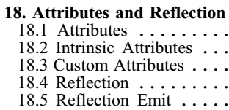
18
Attributes and Reflection

Slide 195
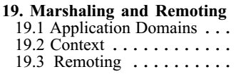
19
Marshaling and Remoting

Slide 196
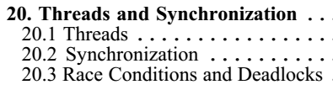
20
Threads and Synchronization

Slide 197
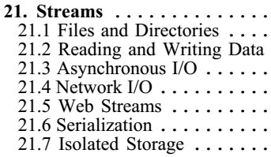
21
Streams

Slide 198
Technology Outburst
Runtime

Slide 199
Technology Outburst
Every 10 years or so a new approach to programming hits like a tsunami.
In the early 1980s, the new technologies were Unix, which could be run on a desktop, and a powerful new language called C, developed by AT&T.
The early 90s brought Windows and C++.
Each of these developments represented a sea change in the way you approached programming.
Now (2002), .NET and C# are the next wave, and this book is intended to help you ride it.
Microsoft has 'bet the company' on .NET.
When a company of their size and influence spends billions of dollars and reorganizes its entire corporate structure to support a new platform, it is reasonable for programmers to take notice.
It turns out that .NET represents a major change in the way you'll think about programming. It is, in short, a new development platform designed to facilitate object-oriented Internet development.
The programming language of choice for this object-oriented Internet-centric platform is C#, which builds on the lessons learned from C (high performance), C++ (object-oriented structure), Java (garbage collected, high security), and Visual Basic (rapid development) to create a new language ideally suited for developing component-based n-tier distributed web applications.

Slide 200
Runtime
A runtime is an environment in which programs are executed.
The Common Language Runtime (CLR) is the heart of .NET.
It includes a data-typing system which is enforced throughout the platform and which is common to all languages developed for .NET.
The CLR is responsible for processes such as memory management and reference counting of objects.
Another key feature of the .NET CLR is garbage collection.
Unlike with traditional C/C++ programming, in C# the developer is not responsible for destroying objects.
Endless hours spent searching for memory leaks are a thing of the past; the CLR cleans up after you when your objects are no longer in use.
The CLR's garbage collector checks the heap for unreferenced objects and frees the memory used by these objects.

